Slide 1
Writing Queries
Jeremy Bergmann - Omaha Data Science Academy

Slide 2
Review: Class 1 – Basics
What is the need for Data Manipulation & Management?
What is a database?
What is SQL? Why learn SQL?
What is a table? How do you create a table? How do you insert data into a table?
What are the most common SQL data types?
What is a SQL Query?
Notes:
Feynman technique: Learn -> Explain -> Reflect -> Repeat
What are the most important ideas from last class? Write a summary of the information as if explaining to a 14 year old. Avoid jargon Keep the words and sentences simple Rely on memory Make the explanation visual, if possible Note where you had difficulty or have knowledge gaps. These indicate things you should review, research, or ask questions about

Slide 3
Class 2 Objectives
Practice using common SQL clauses
Practice using common aggregations
Practice using comments for debugging or explaining code
Learn SQL functions
Practice writing subqueries
Practice using SQL by examples in MySQL Workbench
Notes:
Feynman technique: Learn -> Explain -> Reflect -> Repeat
What are the most important ideas from last class? Write a summary of the information as if explaining to a 14 year old. Avoid jargon Keep the words and sentences simple Rely on memory Make the explanation visual, if possible Note where you had difficulty or have knowledge gaps. These indicate things you should review, research, or ask questions about

Slide 4
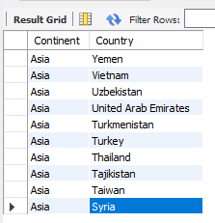
Example - World Query
Obtain a list of countries within the continent of Asia.
SQL Query
SELECT continent, name as country #what columns to get
FROM world.country #what schema/table to read
WHERE continent = ‘asia' #limit results”
ORDER BY continent, country DESC #Sort rows in result”
LIMIT 10 #number of rows to “bring back”
Notes:
SELECT continent, name as country #what columns to get
FROM world.country #what schema/table to read
WHERE continent = ‘asia' #limit results”
ORDER BY continent, country DESC #Sort rows in result”
LIMIT 10 #number of rows to “bring back”

Slide 5
Common SQL Clauses
Purpose: A SQL Clause defines the “order of execution” of a SQL query, along with the required operations to obtain data from a relational database.
Main Clauses | JOIN | WHERE (3) | SELECT (4) | Aggregations (5)
FROM | (INNER) | NOT | DISTINCT | AVG
WHERE | LEFT (OUTER) | AND | AS | COUNT
GROUP BY | FULL OUTER | OR | CASE | SUM
HAVING | RIGHT | LIKE |  | MIN
SELECT | CROSS | BETWEEN |  | MAX
ORDER BY |  | IN
 |  | <, >, <=, >=, =, !=
 |  | NULL
Notes:
“Main clauses” in descending order of operations
Wildcard characters: %, _, *
CASE: if-then statements
JOIN: mostly use INNER, LEFT
HAVING: WHERE for groups (http://www.mysqltutorial.org/mysql-having.aspx)
BETWEEN is inclusive

Slide 6
Example - World Query
Obtain a list of countries within the continent of Asia.
SQL Query
SELECT continent, name as country #what columns to get
FROM world.country #what schema/table to read
WHERE continent = 'asia’ #limit results”
ORDER BY continent, country DESC #Sort rows in result”
LIMIT 10 #number of rows to “bring back”
Notes:
SELECT continent, name as country #what columns to get
FROM world.country #what schema/table to read
WHERE continent = ‘asia' #limit results”
ORDER BY continent, country DESC #Sort rows in result”
LIMIT 10 #number of rows to “bring back”

Slide 7
SQL Operators
Purpose: A comparison (or relational) operator is a mathematical symbol which is used to compare two values, usually in the “where” or “select” clauses of a SQL Query. The result of a comparison can be TRUE, FALSE, or UNKNOWN (an operator that has one or two NULL expressions returns UNKNOWN).
Operator Type | SELECT Clauses
Arithmetic | Add, Subtract, Multiply, Divide
Comparison | Equal to (=), Greater than (>), Less than (<), Greater Than or Equal to (>=)
Logical | AND, BETWEEN, EXISTS, IN, LIKE, NOT, OR
Notes:
“Main clauses” in descending order of operations
LIKE: wildcard searches: %<char>, %<char>%, <char>%, underscores
Wildcard characters: %, _, *
CASE: if-then statements
JOIN: mostly use INNER, LEFT
HAVING: WHERE for groups (http://www.mysqltutorial.org/mysql-having.aspx)
BETWEEN is inclusive

Slide 8
SQL Functions
Aggregate functions: AVG, Count, INSTR, Sum, Min/Max
String functions: Concat, Length, Left, Replace, Substring, Trim, Format
Control flow functions: Case, if, ifnull
Date and Time functions: Curdate, DateDiff, Day/Month/Year, DateAdd, now
Comparison functions: Coalesce, isnull
Math functions: Ceiling/Floor, Round, Truncate
Data Types: CAST
Tutorial: http://www.mysqltutorial.org/mysql-functions.aspx
Notes:
Aggregate Function: aggregate function performs a calculation on a set of values and returns a single value.

Slide 9
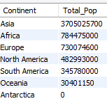
Example - Continent Query
What is the total world population by continent?
SQL Query
SELECT continent, SUM(population) as total_pop
FROM world.country #what schema/table to read data
GROUP BY continent #summarize by group
ORDER BY continent DESC #Sort rows in result
HAVING SUM(population) > 0 #Limit final results of agg.
Notes:
SELECT continent, SUM(population) as total_pop
FROM world.country #what schema/table to read data
GROUP BY continent #summarize by group
ORDER BY continent DESC #Sort rows in result
HAVING SUM(population) > 0 #Limit final results of agg.

Slide 10
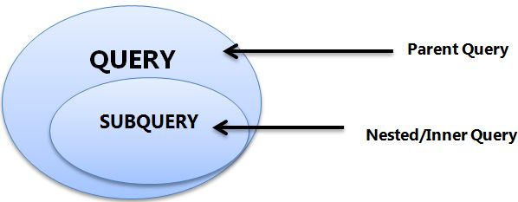
Subqueries
A.K.A. nested queries, inner queries, inner select
Must be enclosed by parentheses
Ex: SELECT <col> FROM <table>WHERE (SELECT <col> FROM <table>);
Can return single value (aka scalar), single row, single column, or table
Evaluated inside-out

Slide 11

Subqueries - Example
Source: https://datapractices.org/courseware/2_7.html

Slide 12

Example - Continent Query
What is the total population of the continent of Asia?
SQL Query
SELECT subq.continent, SUM(subq.population) as total_pop
FROM (
select continent, `name` as country, population
from world.country
where continent = ‘asia'
) AS subq #using subquery
group BY subq.Continent
Subqueries are often used to return a subset of an entire dataset!
Notes:
SELECT subq.continent, SUM(subq.population) as total_pop
FROM (
select continent, `name` as country, population
from world.country
where continent = ‘asia'
) AS subq #using subquery
group BY subq.Continent

Slide 13
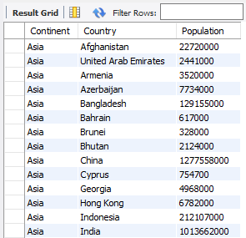
How did it work?
SQL “Inner” Query
SQL “Outer” Query
Summarize the Population of all Asian
Countries by Continent

Slide 14

Exercises
World Schema
1. In world.city, What are the names and CountryCodes of all countries in the database (sorted alphabetically by code)?
2. Return the names of all cities contained in the world.city table that are in the united states.
3. Find the total population of all USA cities that are in the world.city table
4. Return the names of all cities contained in the world.city table that are in Nebraska (Region), using a subquery
5. In the world.country langage table, select all countries where the official language is ‘English’
6. In the world.country table, compare the average life expectancy of people, in a variety of ways.

Slide 15

Appendix - Data Import - MySQL
Purpose - Import Demographic Data, for use with COVID-19 Dataset
STEPS
Analyze Dataset – Column lengths & types
Define & Create Table, based on CSV Columns
Import Data Using “Table Import Wizard”
- Right-Click Table
- Select “Table Data Import Wizard”
Within the “Table Import Wizard”
- Select CSV file
- Select Destination – Use Existing Table
- Configure Import Setting – Column Types, Encoding (utf-8)
Import Data – Click Next, Monitor Import Log
- Create “Select *” script to check results
Example: https://www.youtube.com/watch?v=vzYFZXI43hM
Notes:
A derived table is the result of a query that looks like a table.

Slide 16


